Slide 1
Geometric Nonlinear Isogeometric Shell Element Validation
Aakash Ravichandran M.Sc Civil Engineering Technical University of Munich

Slide 2
Contents
Objective
Model Description
Study
Conclusion

Slide 3
Objective
Model Description
Study
Conclusion

Slide 4
Objective
To validate the Geometric Nonlinear Analysis of the shell element with different types of patches in the Kratos IGA application.

Slide 5
Objective
Model Description
Study
Conclusion

Slide 6
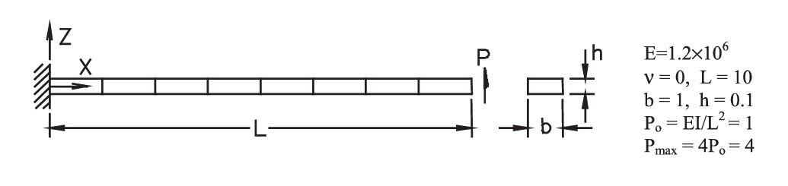
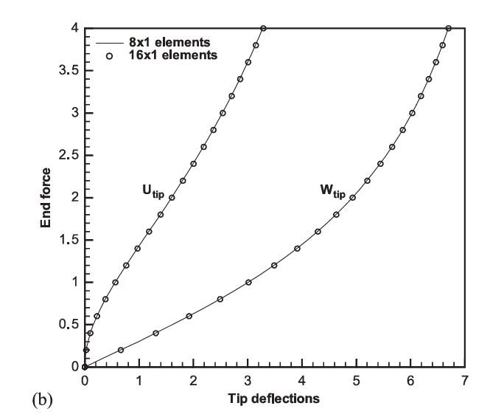
Model Description

Slide 7
Objective
Model Description
Study
Conclusion

Slide 8
Study
The following types of patches were studied.
1. Single Patch
2. Matching Patches
3. Non-Matching Patches
4. Straight Trimmed Patches
5. Curved Trimmed Patches

Slide 9
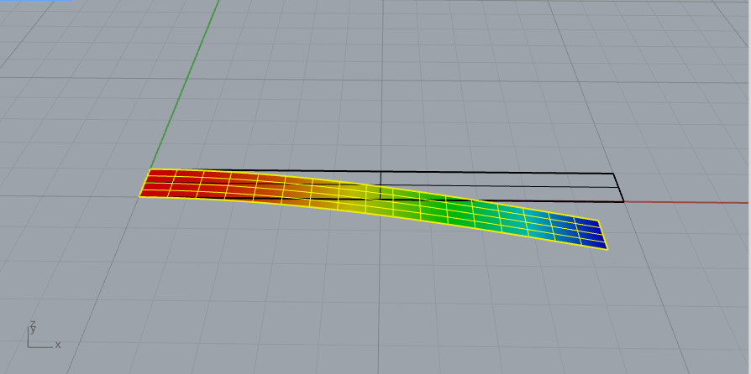
Study - Single Patch

Slide 10
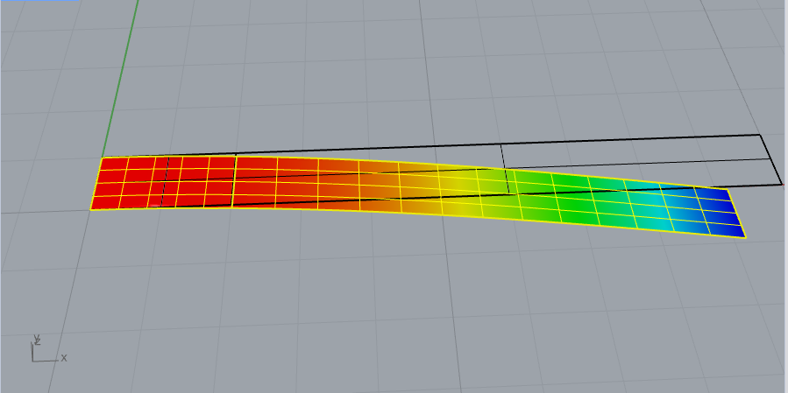
Study - Matching Patches

Slide 11
Study - Non-Matching Patches

Slide 12
Study - Non-Matching Patches

Slide 13
Implicit Vertex Morphing
Free-form Vs Implicit VM
Radius of Filter
Point Displacement constraint

Slide 14
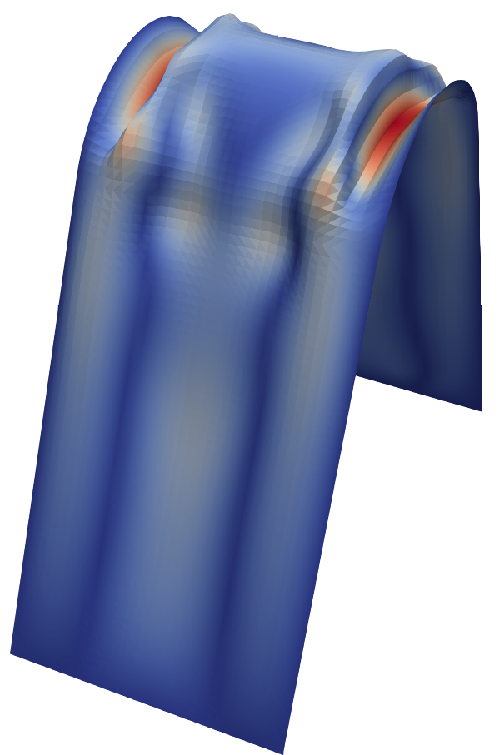
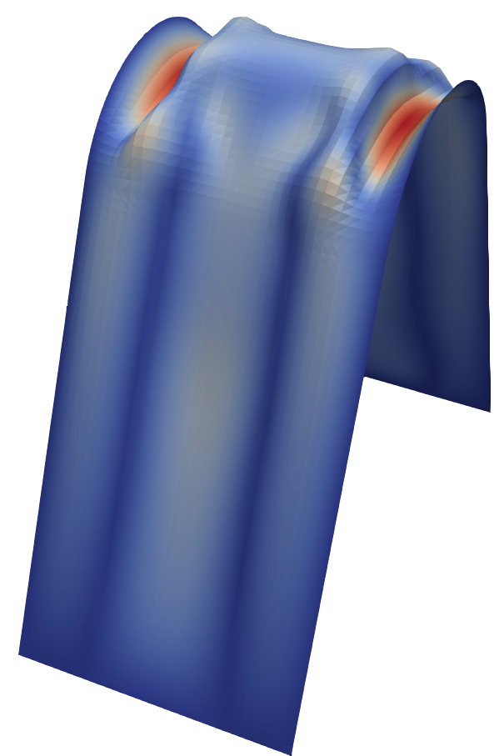
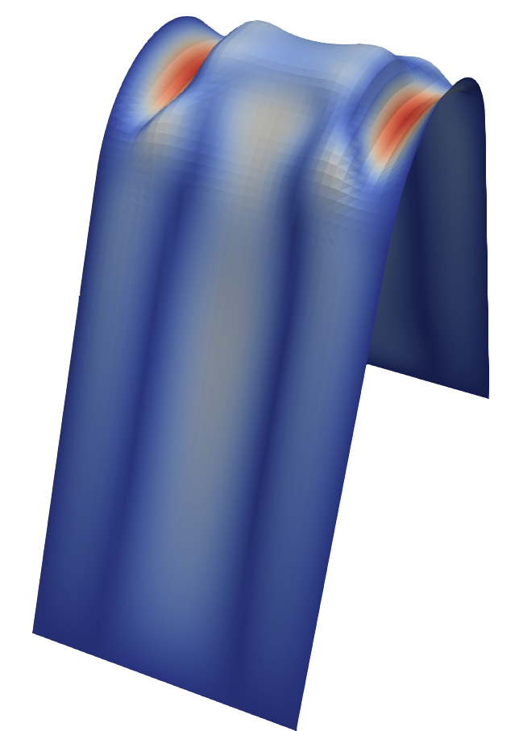

Filter Radius
Archara – Absolute update
Radius: 5
Radius: 6.5
Radius: 8
Radius: 11

Slide 15
Thank You

